Slide 1
Team 108 Spreadsheet
Jonah Nidorf, Peter Benson, Timothy Porter
Link to Youtube Video

Slide 2
Demo of the system (live demo)
Value and formulas - enter some values and formulas that refer to other cells
How formulas are recalculated when cell references are edited
How formulas are affected by row/col insertion/deletion

Slide 3
Three additional features (live demo)
Undo/Redo
Import/Export
Statistical analysis

Slide 4
Overall system architecture
At a high-level, most of our back-end logic is contained within the Spreadsheet and Cell classes
The Spreadsheet class:
Handles core system functionality such as creating new spreadsheets, inserting and removing rows and columns, loading in data, and keeping track of all actions so that the user can undo/redo their changes.
Stores a 2D array of Cells
The Cell class:
Contains the logic that parses all arithmetic, formulas, cell references, range based expressions, and statistical analysis.
Utilizes custom literal objects; defined in the StringLiteral, NumberLiteral, and ErrorLiteral classes
Our front-end architecture is broken up into various React classes and some accompanying css code that make up the buttons, tables, pop-ups, and other UI components
Buttons have been abstracted into an interface that are concretely implemented as various subclasses such as the UndoButton, AddColButton, NewSpreadsheetButton, etc. which are used in the TopBar class that stores most of our UI components

Slide 5
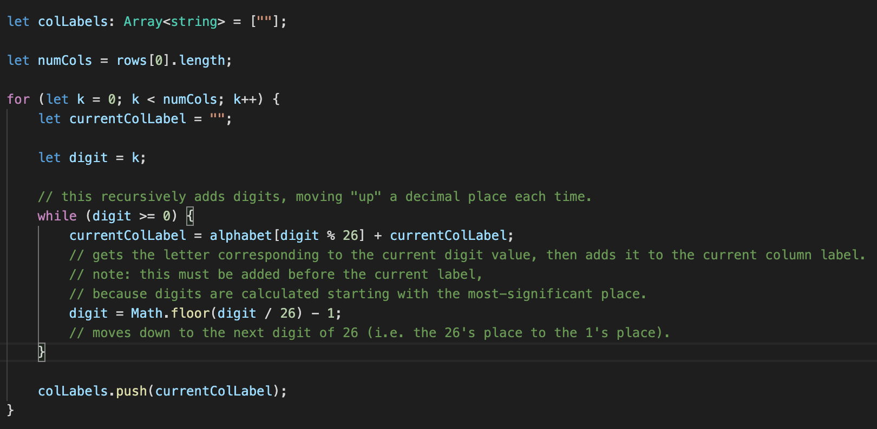
Interesting code snippet

Slide 6
Lessons learned/retrospective
One challenge was learning a new framework. After completing this project, I would have designed the React structure differently.
Pivoting between approaches went well. We were able to easily and swiftly refactor – for example, when we refactored the Cell formula parsing.
Communication and software development lifecycle could have been improved. We should have implemented more development methods, such as Test-Driven-Development and a more structured form of code review.

Slide 7
Thank You!

